Slide 1

Pattern Classification

Slide 2

Chapter 3:
Maximum-Likelihood & Bayesian Parameter Estimation (3.1,3.2)
Introduction
Maximum-Likelihood Estimation
  The Gaussian Case 1:unknown μ
  The Gaussian Case 2: unknown μ and σ
  Bias

Slide 3

3.1 Introduction
Data availability in a Bayesian framework
  We could design an optimal classifier if we knew:
    P(ω_{i}) (priors)
    P(x | ω_{i}) (class-conditional densities)—Unknown parameters
    Unfortunately, we rarely have both complete information!
Design a classifier from a training sample
  No problem with the estimation of prior probabilities
  Samples are often too few for the estimation of class-conditional densities
  Complexity for large dimension of feature space

Slide 4

  To simplify above problem
    Normality of P(x | ω_{i})
    P(x | ω_{i}) ~ N( μ_{i}, Σ_{i}): Characterized by 2 parameters
    The problem is changed from estimating P(x | ω_{i}) to estimating μ_{i}, Σ_{i}
Estimation techniques
  Maximum-Likelihood (ML) and the Bayesian estimations
  Results are nearly identical, but the approaches are conceptually different

Slide 5

  Parameters in ML estimation are fixed but unknown!
  Best parameters are obtained by maximizing the probability of obtaining the samples observed
  Bayesian methods view the parameters as random variables having some known prior distribution. Training data allow us to convert a distribution on this variable into a posterior probability density
  In either approach, we use P(ω_{i} | x)
  for our classification rule!

Slide 6

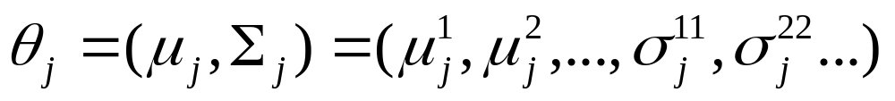
3.2 Maximum-Likelihood Estimation
M-L Estimation
  Has good convergence properties as the sample size increases
  Simpler than any other alternative techniques
General principle
  Assume we have c classes and
    p(x | ω_{j}) ~ N( μ_{j}, Σ_{j})
    p(x | ω_{j}) ≡ p (x | ω_{j}, θ_{j}) where:

Slide 7

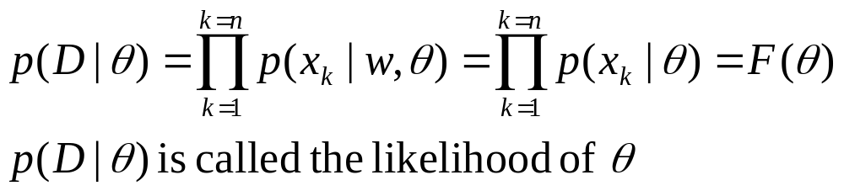

  Use the information
  provided by the training samples D = (D1, D₂, …, D_{c}) to estimate
    θ = (θ₁, θ₂, …, θ_{c}), each θ_{i} (i = 1, 2, …, c) is associated with each category.
    assume D_{i} give no information about θ_{j} if i<>j
    So we use each class separately to simplify our notation
    Suppose that D contains n samples, x₁, x₂,…, x_{n}
  ML estimation of θ is, by definition, the value that maximizes p(D | θ)
    “It is the value of θ that best agrees with the actually observed training sample”

Slide 8

ML Problem Statement
  Let D = {x₁, x₂, …, x_{n}}
  p(x₁,…, x_{n} | θ) = Π^{1,…,n}P(x_{k} | θ); |D| = n
  Our goal is to determine (value of θ that makes this sample the most representative!)

Slide 9

|D| = n
.
.
.
.
x₂
x₁
.
.
x_{n}
N(μ_{j}, Σ_{j}) = P(x_{j},|ω_{c})
P(x_{j} | ω₁)
P(x_{j} | ω_{k})
.
x₁₁
.
x₁₀
D_{c}
.
.
.
.
x₂₀
D_{k}
D₁
x₈
.
.
.
.
x₁
x₉
.
.

Slide 10
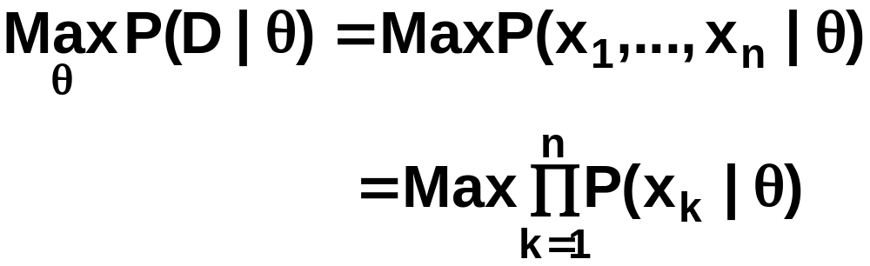


θ = (θ₁, θ₂, …, θ_{c})
Problem: find such that:

Slide 11
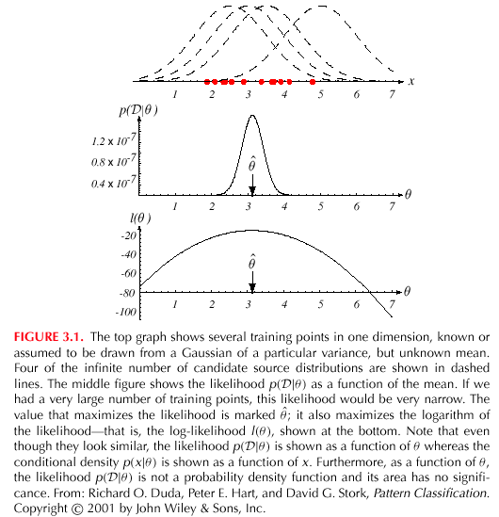

2

Slide 12
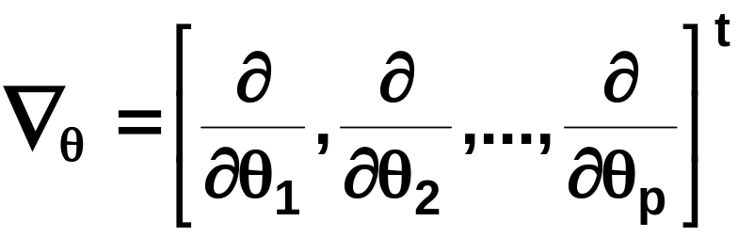

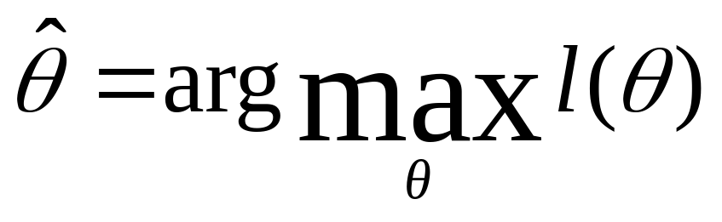

  Optimal estimation
    Let θ = (θ₁, θ₂, …, θ_{p})^{t} and let ∇_{θ} be the gradient operator
    We define l(θ) as the log-likelihood function
  l(θ) = ln p(D | θ)
    New problem statement:
  determine θ that maximizes the log-likelihood

Slide 13
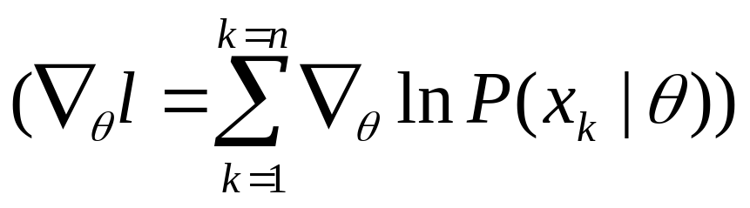
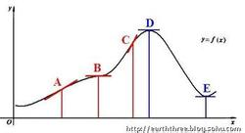
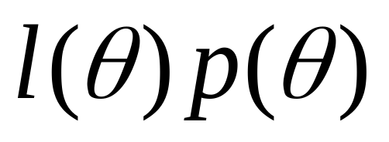
    Set of necessary conditions for an optimum is:
    ∇_{θ}l = 0
    Global maximum, local maximum or minimum, inflection point
    For reference: MAP estimators (Max a posteriori)

Slide 14
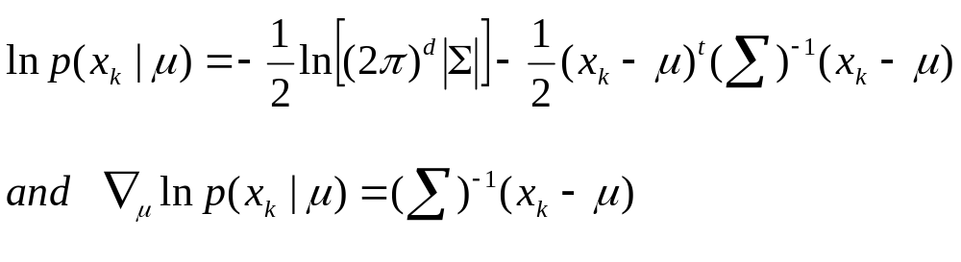
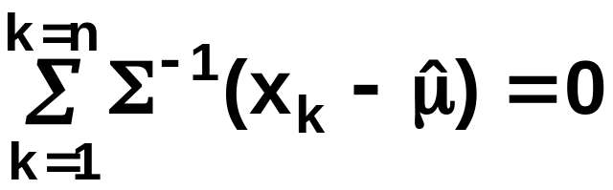
Example of a specific case 1: unknown μ
  p(x_{i} | μ) ~ N(μ, Σ)
  (Samples are drawn from a multivariate normal population)
  The ML estimate for μ must satisfy:
2

Slide 15

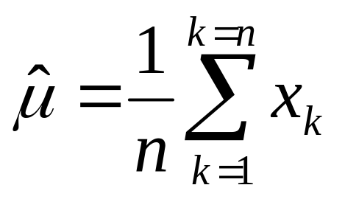
  Multiplying by Σ and rearranging, we obtain:
    Just the arithmetic average of the samples of the training samples!
Conclusion:
    If P(x_{k} | ω_{j}) (j = 1, 2, …, c) is supposed to be Gaussian in a d-dimensional feature space; then we can estimate the vector
    θ = (θ₁, θ₂, …, θ_{c})^{t} and perform an optimal classification!

Slide 16
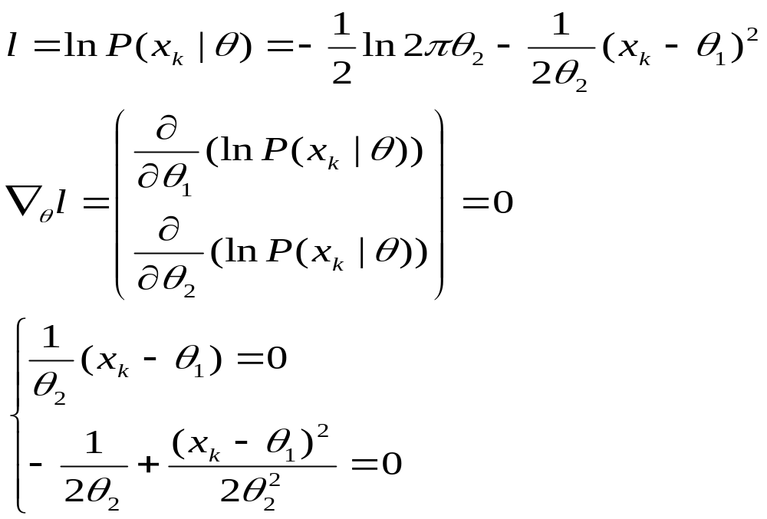
Example of a specific case 2
  Gaussian Case: unknown μ and σ
  θ = (θ₁, θ₂) = (μ, σ²)

Slide 17
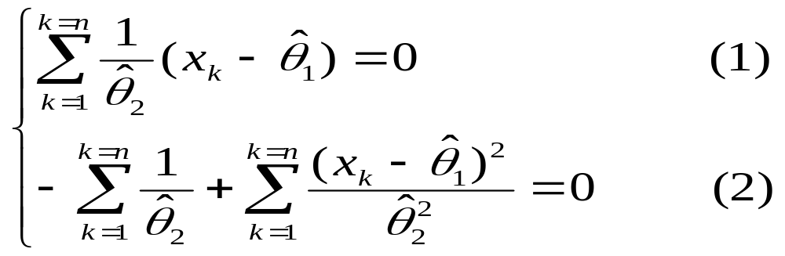
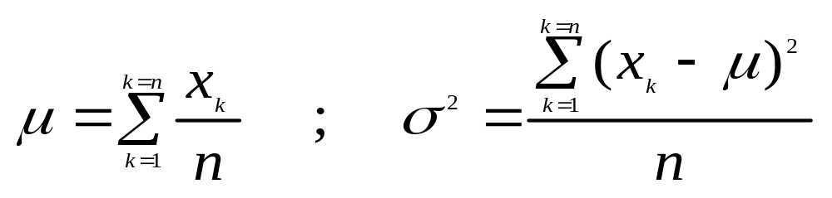
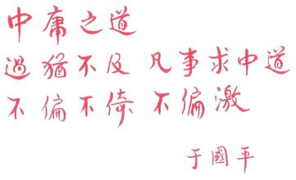

Summation:
Combining (1) and (2), one obtains:
2

Slide 18
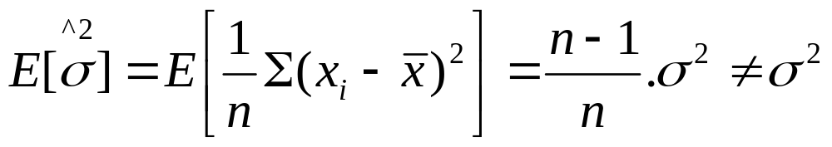
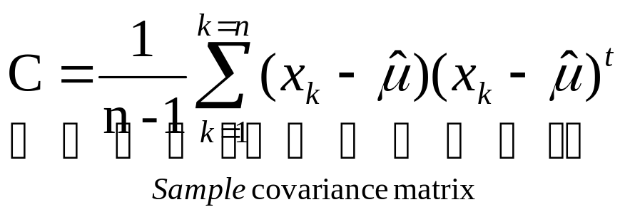
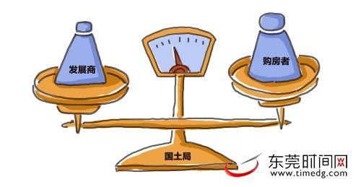
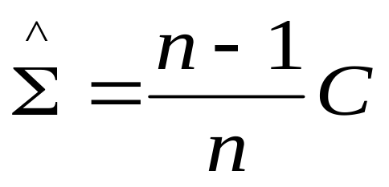
Bias
  ML estimate for σ² is biased
  An elementary unbiased estimator for Σ is:
  ML estimate for Σ is biased

Slide 19
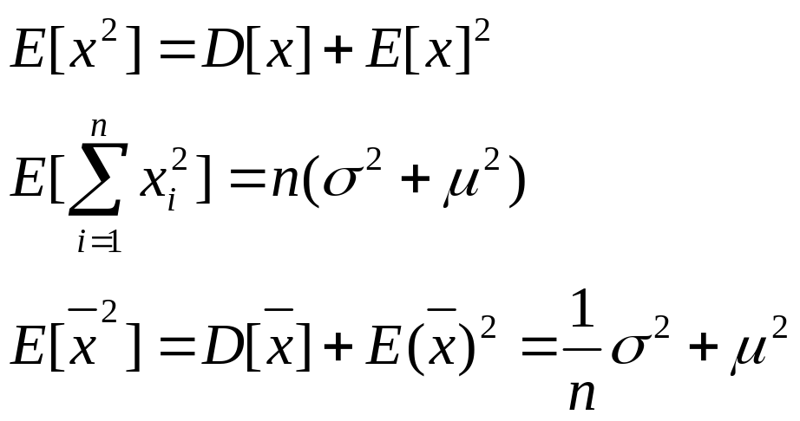
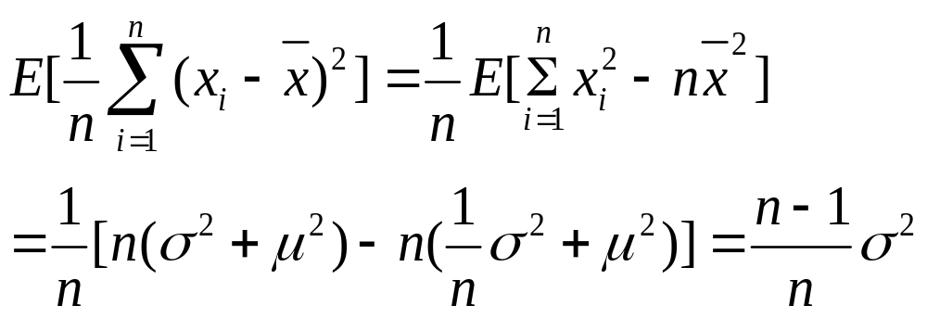
  Absolutely unbiased, asymptotically unbiased
  Prove ML estimate for σ² is biased

